Slide 1
Intelligent Communities
Making it Happen!
Jim Gragtmans
April 2014

Slide 2
…looking for the ‘Break Out’

Slide 3
Intelligent Communities Solving for ‘X’
Huge Problem
Breakthrough Technology
Radical Solution
‘X’

Slide 4
Where to? How do we get there?

Slide 5
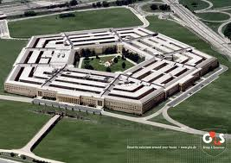
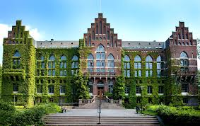
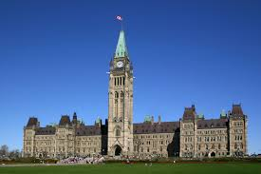
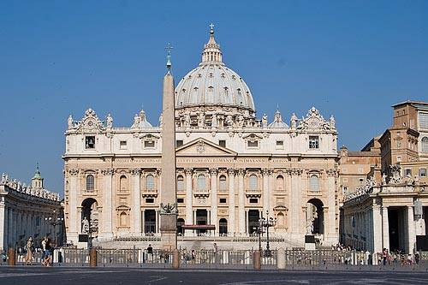
Institutional Organizations The Traditional Model

Slide 6
Institutional Models
Large, Exclusive
Highly organized
Strict governance
Hierarchical management structure
Limit flexibility
Limit Innovation

Slide 7
Silos to Collaborative Partnerships

Slide 8
Community Collaboration - how to manage without institutionalizing?
Municipality
Business
Education
Health
Non-Profit
Individuals
Transportation

Slide 9
Collaborative vs Institutional
New partnerships

Slide 10
Collaborative Organizations
Inclusive Membership of Stakeholders
Innovative, Flexible, Agile
Loose governance model
Use Technology for organizational management
‘Messy Vibrancy’
Operate on Principal of ‘Shared Values’
Beyond ‘Common Goals’

Slide 11
Making It Happen!
Ideas
Projects
Results

Slide 12
Community Collaboration Ecosystem
Why are we doing this?
How do we measure impact?
Who decides what we do?
What are we going to do first?
Who is going to take action?

Slide 13
Community Collaboration Ecosystem
Technology Platform
Project Curation
Governance
Charter & Rules of Engagement
Community Well Being

Slide 14
Communities Working on this
Toronto
Waterfront Toronto
Newmarket
Community Collaboration Ecosystem
Waterloo
Smart Region
Saint John, NB
Enterprise Saint John
St Albert
Winnipeg

Slide 15
Lets Collaborate!
Jim Gragtmans
jgragtmans@etgroup.ca
416 477 2576

